Slide 1
Building a PowerShell module for Bicep using C#
almost 1.000.000 1.500.000 downloads later
Emanuel Palm & Simon Wåhlin
Notes:
SIMON

Slide 2

Notes:
It all started in August of 2020, bicep was released in it’s first alpha version
(1) brendandburns on Twitter: "Are you interested in helping shape the future of @Azure Resource Manager templates? Want to just geek out about configuration languages (I mean who doesn't) Come check out the OSS @BicepLang project: https://t.co/Ib3vquyIxp We look forward to seeing you there! #BicepLang" / Twitter

Slide 3
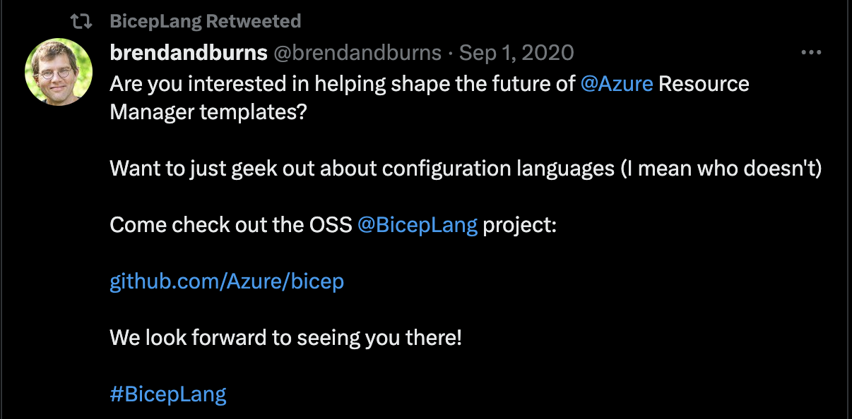
Notes:
It all started in August of 2020, bicep was released in it’s first alpha version
(1) brendandburns on Twitter: "Are you interested in helping shape the future of @Azure Resource Manager templates? Want to just geek out about configuration languages (I mean who doesn't) Come check out the OSS @BicepLang project: https://t.co/Ib3vquyIxp We look forward to seeing you there! #BicepLang" / Twitter

Slide 4


Notes:
We were super happy! Finally a native deployment tool for Azure that didn’t make your eyes hurt! We started using it on day one!
It was an early alpha and naturally, there were a few rough edges and things that the product group didn’t prioritize early on.

Slide 5
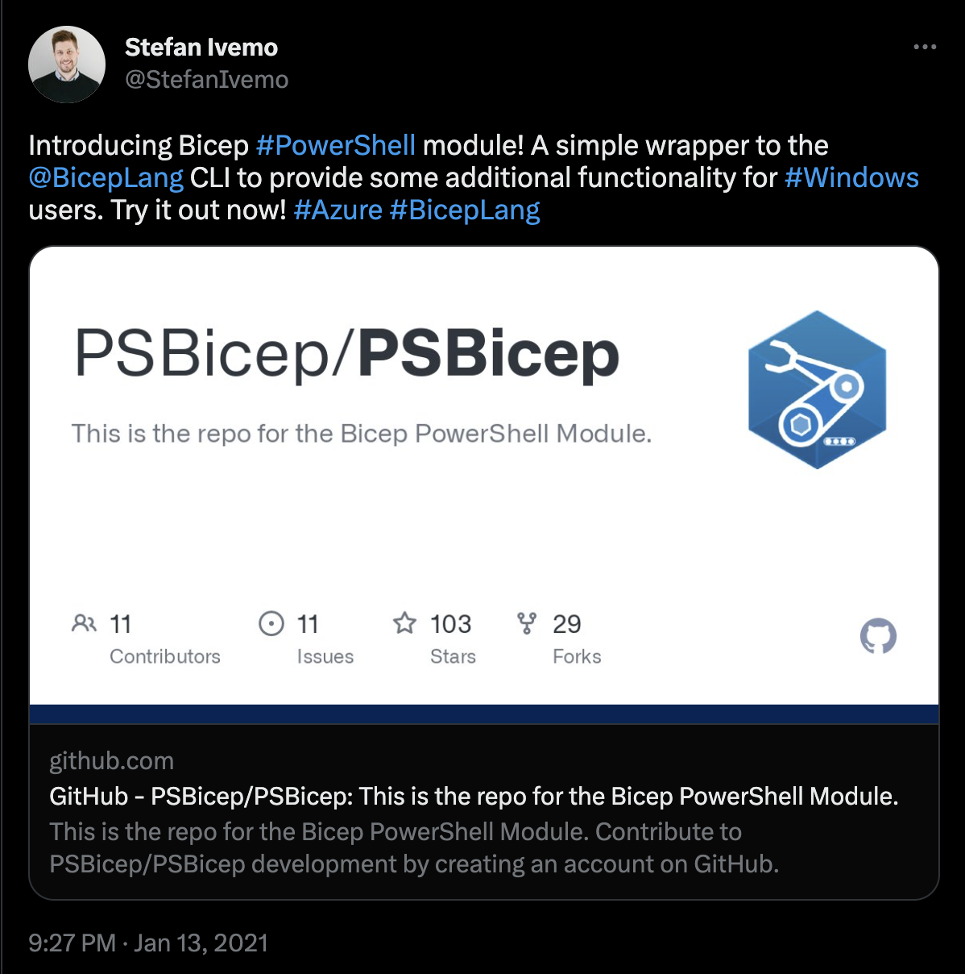
Notes:
Our friend Stefan wrote a few scripts to make it easier.
Those scripts quickly became a module
Stefan Ivemo on Twitter: "Introducing Bicep #PowerShell module! A simple wrapper to the @BicepLang CLI to provide some additional functionality for #Windows users. Try it out now! #Azure #BicepLang https://t.co/FMZEmEMHVp" / Twitter

Slide 6
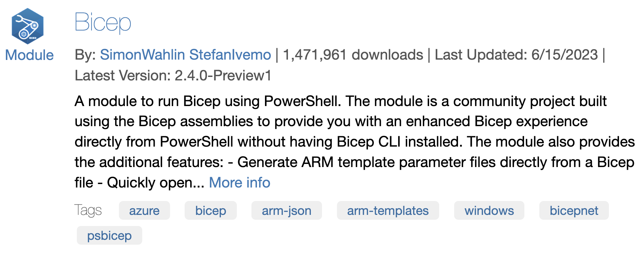
Notes:
Today we’re going to tell you a story about how we wrote a PowerShell module, just to scratch an itch and have some fun and roughly two years later, we hit one million downloads.

Slide 7
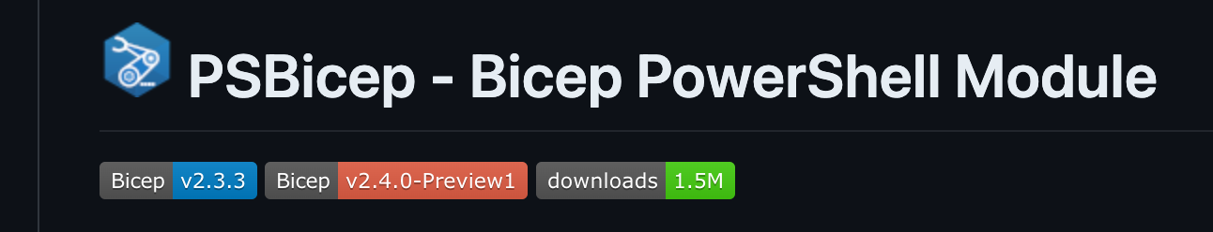

Notes:
Today we’re going to tell you a story about how we wrote a PowerShell module, just to scratch an itch and have some fun and roughly two years later, we hit one million downloads.

Slide 8


Emanuel & Simon
Cloud Consultants by day
Coders by night
PowerShell fans all the time

Slide 9

Many thanks to our sponsors:

Slide 10
Initial Commands
Install/Uninstall-BicepCLI
Invoke-BicepBuild (now Build-Bicep)
ConvertTo-Bicep
New-BicepParameterFile
Notes:
At first, the module only contained simple functions and all bicep functionality depended on calling the bicep cli.

Slide 11
Calling Bicep.exe
using Bicep.Core
Parsing output is hard
Richer output
Bicep only supported files
Could build to strings
Shelling out felt “dirty”
Was more fun!

Slide 12




Open-Source Spirit
Team
Contributors
Community
Linux
Notes:
Engagement from several friends
Project grew to a total of 8 contributors
We got indicators of others using our module
Linux support required

Slide 13

But…
Notes:
EMANUEL
10 min
We quite soon realized we might have bitten of more than we could chew...

Slide 14
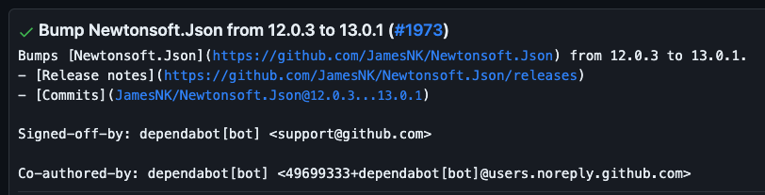
Dependency conflict #1

Slide 15


DLL Dependency hell
PSBicep v1.4.4
Bicep v0.3.255
💥
Newtonsoft.Json.dll v13.0.1
Newtonsoft.Json.dll v12.0.3

Slide 16
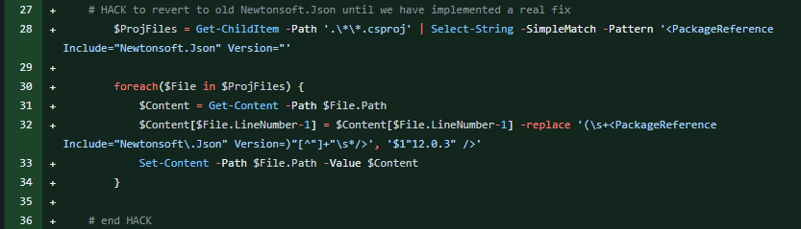
The Hack – downgrading Newtonsoft.Json

Slide 17
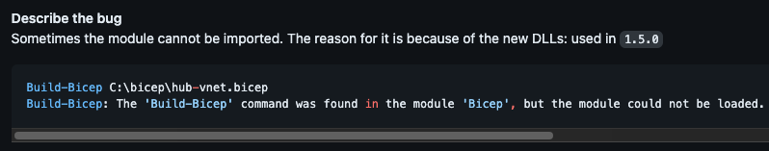
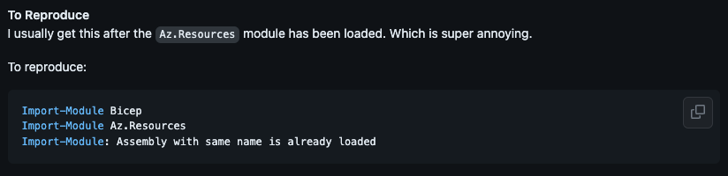
Dependency conflict #2

Slide 18
DLL Dependency hell
DLL Dependency hell
PSBicep v1.5.0
Bicep v0.4.63
Az.Resources v4.2.0
💥
Microsoft.Extensions.Primitives.dll v5.0.0.0
Microsoft.Extensions.Primitives.dll v2.2.0.0

Slide 19
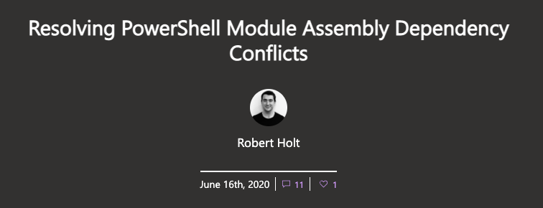
A Seed for a Solution
DLL Dependency hell
Notes:
Almost a year earlier, we had read a fantastic post on ALCs by Robert Holt from the then-PowerShell team. The concept was archived somewhere in our brains, and it was time to resurface it.

Slide 20



AssemblyLoadContext?
Each ALC can load one version of an assembly
PowerShell only uses one ALC
[System.Runtime.Loader.AssemblyLoadContext]::Default
Notes:
Introduced in .NET Core, now called just .NET, replaces isolation functionality from AppDomains in .NET Framework

Slide 21
BicepNet - Implementing the ALC
Hide dependencies from PowerShell
Limit default ALC
Override module loading logic
Create our own ALC
Never expose Bicep dependencies directly!
Wrap types and logic

Slide 22



Implementing the ALC
PowerShell
Module in PS
PSBicep
Other Module
Default ALC
BicepNet.PS
Module in C#
Bicep
Assembly X Version B
Assembly X Version A
Bicep wrapper
BicepNet.Core
Bicep source
Custom ALC

Slide 23

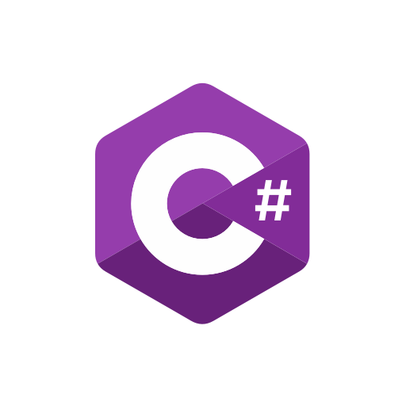

Current Solution
PSBicep/BicepNet
Azure/Bicep
Bicep source code
BicepNet.Core
PSBicep/PSBicep
Bicep PowerShell module
BicepNet.PS
Notes:
MIT

Slide 24
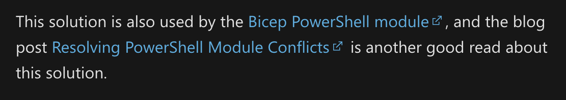
We made the PowerShell documentation
Notes:
SIMON
30 min

Slide 25
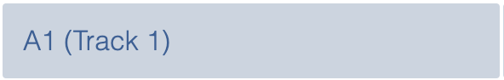
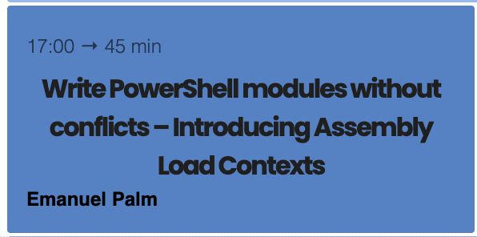
Wednesday, 21 June 2023
Notes:
SIMON
PUSH EMANUELS SESSION

Slide 26



Where are we today?
Full Bicep functionality
Faster than CLI
Extra features
Rich output

Slide 27
Breaking changes
Bicep requires .NET 7
We require PowerShell 7.3
GitHub Runner-Images uses PowerShell 7.2 LTS

Slide 28
Demo

Slide 29



Roadmap
</>
Bulk Export
Deploying to Azure
Syntax Tree

Slide 30
Goals
⏩
Keep up to date with Bicep
Keep learning
Create niche features that may not make it to Bicep
📘
⭐

Slide 31
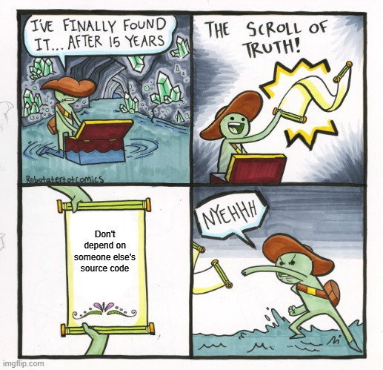
Notes:
EMANUEL

Slide 32
